Slide 1
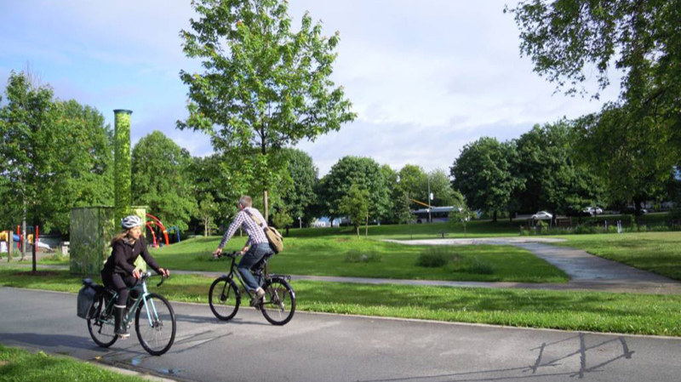
FINAL PROJECT
29 January 2020
This Photo by Unknown author is licensed under CC BY-SA-NC.

Slide 2

Agenda
Introduction to the team
Introduction to the topic – status quo
USP & value proposition
Available data
Solution

Slide 3
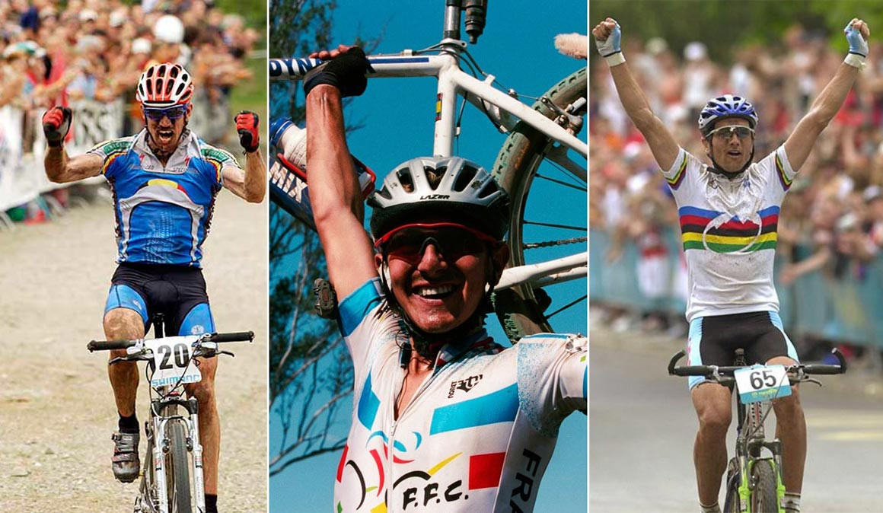
Introduction to the team
Global Head of Visualization Manager – Ketevan Kakabadze
Bachelor in Business Administrations – Ms in Economics – Ms in Big Data Solutions
Data Analyst Intern – Alejandro Schwartz
Bachelor in Actuarial Science – MBA – Ms in Big Data Solutions
CEO – Marcel Rosenberger
Bachelor in Business Administration, Ms in Big Data Solutions

Slide 4

Introduction to the topic
General overview about climate change
Barcelona City Council has declared the Climate Emergency, with an action plan and a budget of 563 million euros to implement a hundred different measures. The goal is to halve greenhouse-gas emissions by 2030 in comparison to levels recorded in 1992, and to cut CO2 emissions by two million tonnes.
The Climate Plan specifies the goals […] with the target of being a carbon neutral city by 2050.
The plan has 6 pillars of action:
Mobility
Urban Planning
Energy
Economy
Food
Consumption and waste
Notes:
Mention the restriction for cars in the urban center (weekends during specific times)

Slide 5
Introduction to the topic
Biking in the city of Barcelona
+100K subscribers (+10% Annual Growth)
+1MM monthly uses
+44K labour day uses
13mins avg. Way
46% women/54% men
+35% get the bike through the app
Mostly 25-34 yrs. old
184 kilometres of bike paths
By 2020 7K bikes – with 2k electric and 500 stations (424 atm)
NPS 6.9
89% of Barcelona citizens has a bike path at least 300 meters away from home

Slide 6
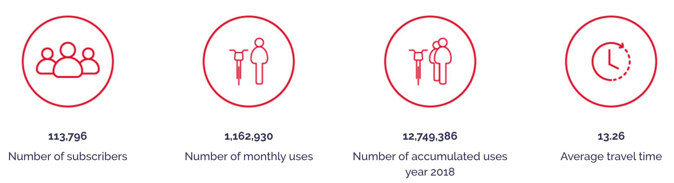
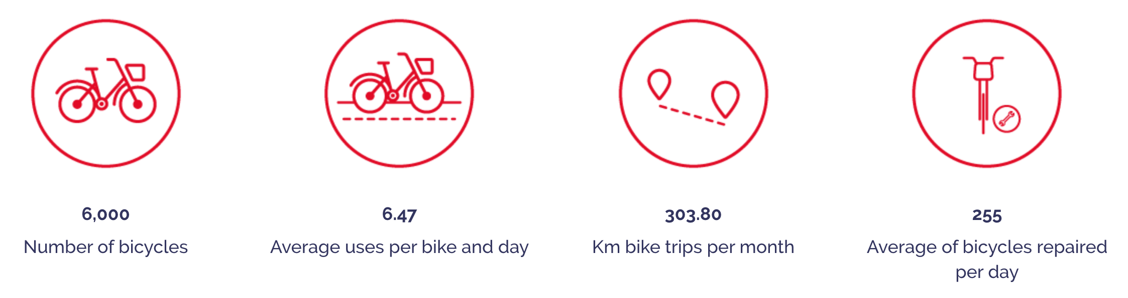
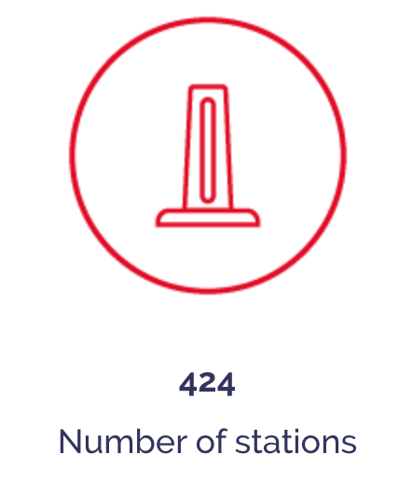
Bicing in Barcelona
And more facts:
184 kilometres of bike paths
+35% get the bike through the app
Mostly 25-34 years old
+44K labour day uses
By 2020 7K bikes – with 2K electric and 500 stations
Net promote score 6.9
89% of Barcelona citizens has a bike path at least 300 meters away from home

Slide 7
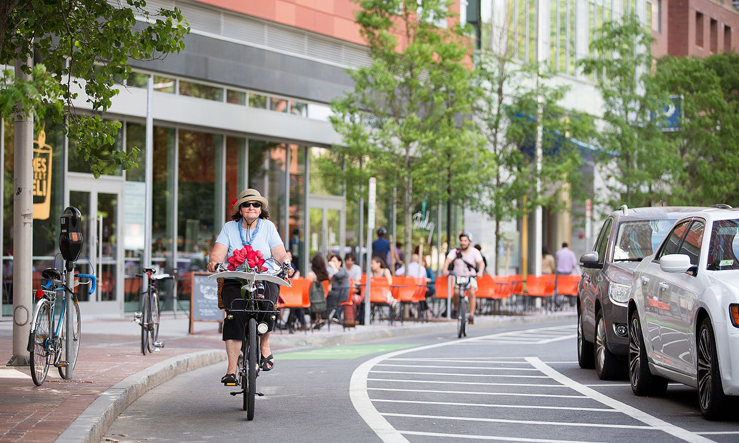
Pains and gains of biking in the city
Pains:
Bike paths often go along streets with lots of traffic
Unsafe and polluted
Bike paths often lead to a dead end without signs for further directions
Traffics light intervals are rather set for cars than bikers
Road conditions are not the best
Gains:
Wide bike network
Easly accessible (money and distance)
Healthy exercise
Environmentally friendly
Fastest way to get around
This Photo by Unknown author is licensed under CC BY-SA.

Slide 8
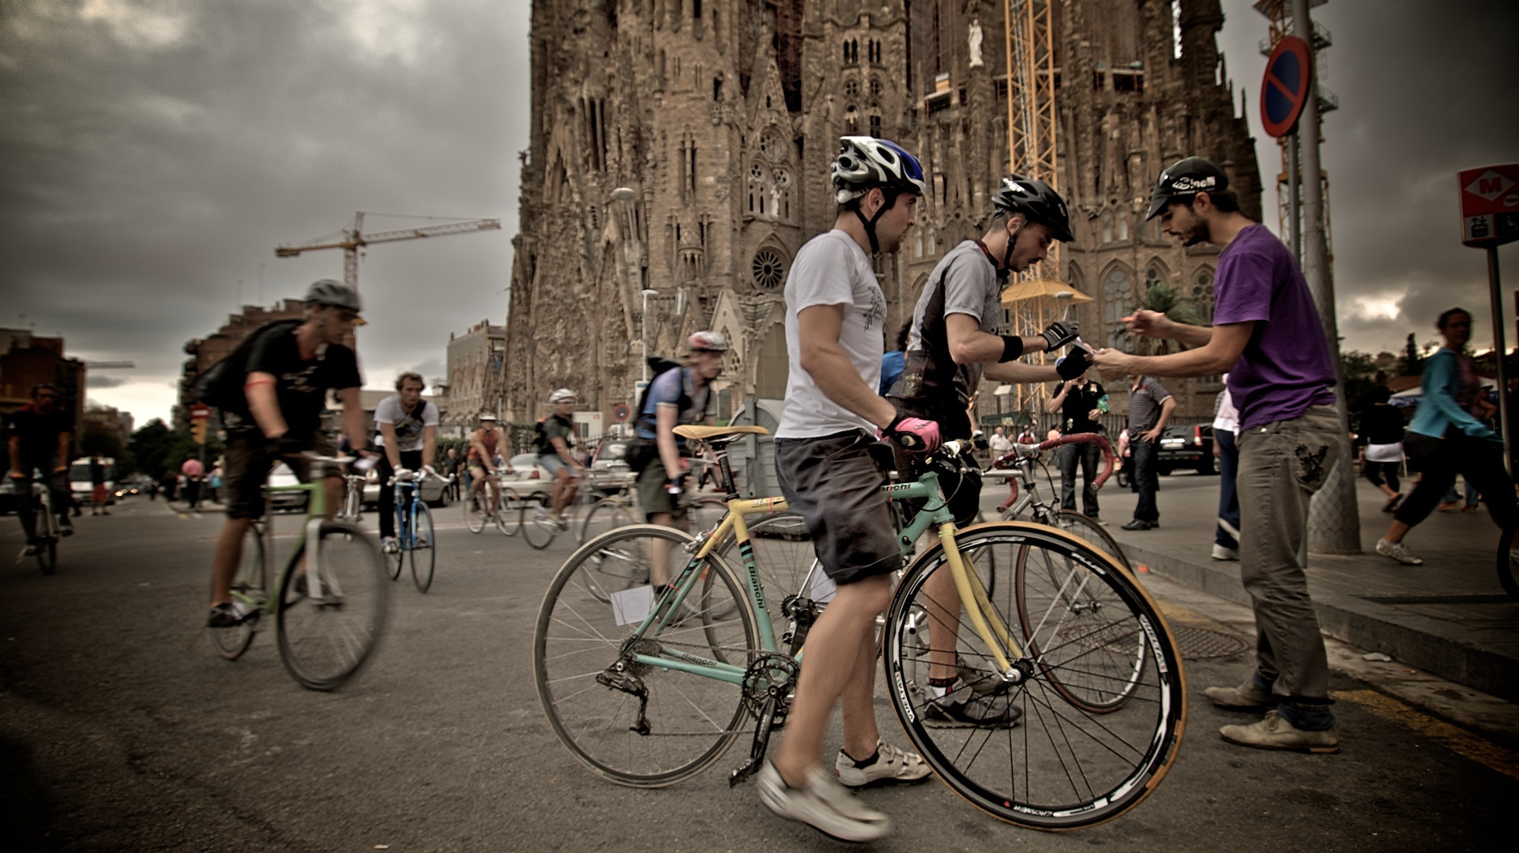
Challenge
"Creating a solution for bikers to find healthier and safer routes"
Who? - for bikers or route planners such as government
What? - Route optimization taking care about the tradeoff for people health and time consumption.
Why? - Help Barcelona climate emergency and improve people life quality. Encourage more people to bike the city!
This Photo by Unknown author is licensed under CC BY-SA.

Slide 9
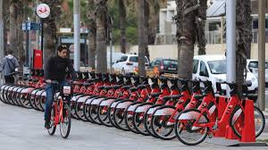
USP & value proposition
Support existing bikers and gain new ones through additional features
Contributing to a healthier and safer cycle route by choosing unpolluted, less frequented routes by cars and in better conditions
Creating advantages to increase the usage of biking in cities
Other maps are suggesting routes but without information about air pollution and noise

Slide 10
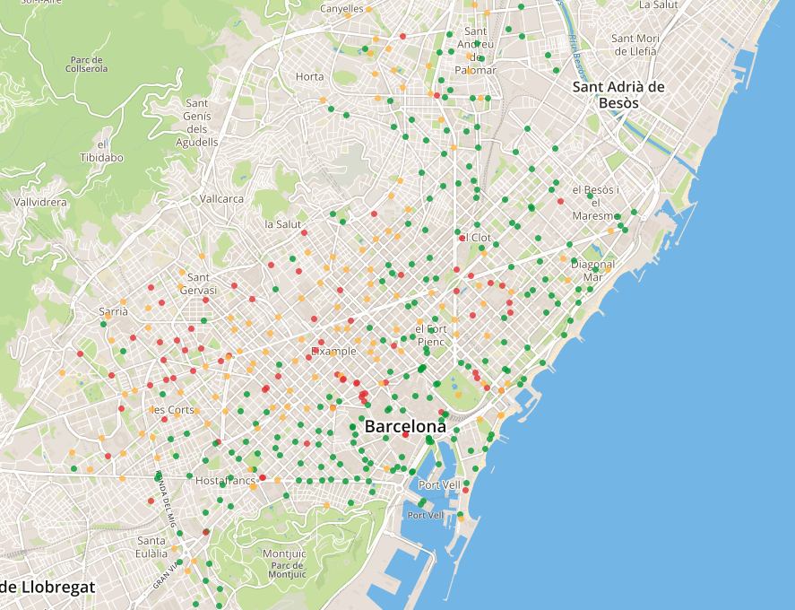
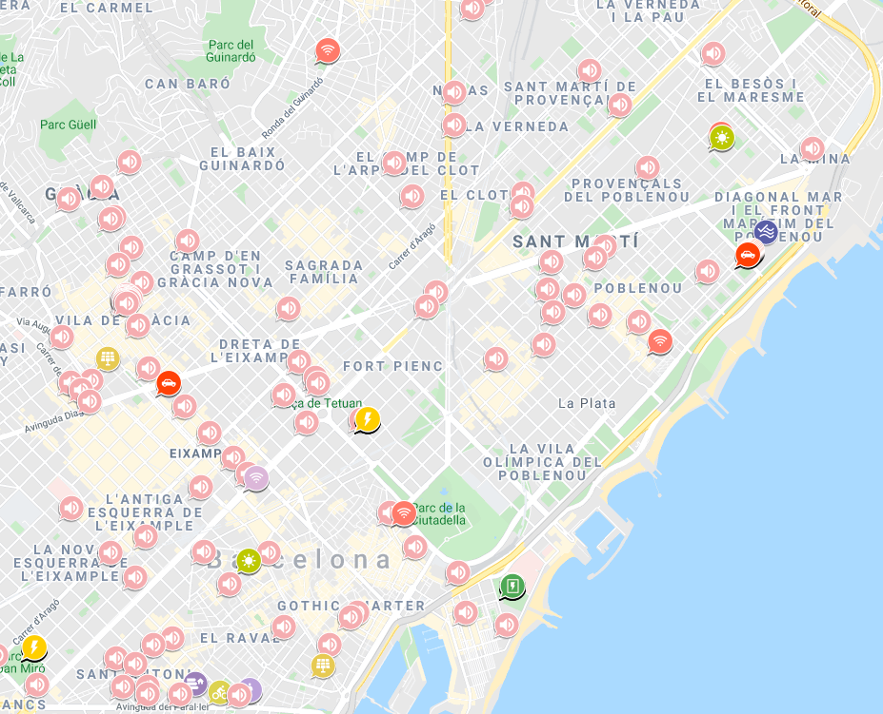
Available data
Bicing stations of the city of Barcelona (parked bikes and empty spots - mechanics and electrics)
https://opendata-ajuntament.barcelona.cat/data/dataset/bicing
Cycle paths in the city of Barcelona
https://opendata-ajuntament.barcelona.cat/data/en/dataset/vies-ciclables
Bicycle lanes in construction in the city of Barcelona
https://opendata-ajuntament.barcelona.cat/data/en/dataset/carrils-bici-en-construccio
Weather information
https://opendata-ajuntament.barcelona.cat/data/en/dataset/prediccio-meteorologica-del-barcelones
Sound sensors
http://sentilo.bcn.cat/connecta-catalog-web/component/map
Pollution data Barcelona
http://aqicn.org/map/barcelona/
Bicing Statistics
https://www.bicing.barcelona/es/datos-bicing##reference-1
API Streets and coordinates Barcelona
http://barcelonaapi.marcpous.com/traffic/streets

Slide 11
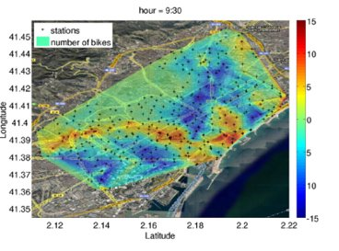
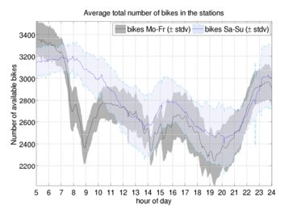
Available Data
[Possible first analysis with data already available]

Slide 12
Data [Nice to Have]
Bike path direction
Routes (starting point – destination – ending point)
Whole route data (not only start and ending point)
Pollution index
Traffic lights

Slide 13
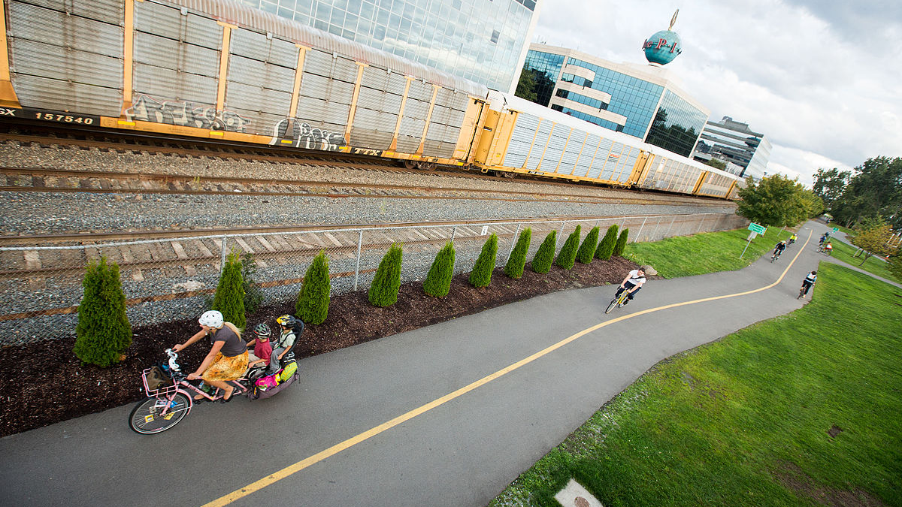
Short & Long Term - Scalability
Short term
Recommend alternative unpolluted, less noisy and shady routes
Long term:
Help bike planners and city governments to optimize the bike paths and station locations.
Scale recommendations for others last mile mobility solutions.
Help implementing routes in other cities less developed in terms of bike planning
This Photo by Unknown author is licensed under CC BY-SA.

Slide 14
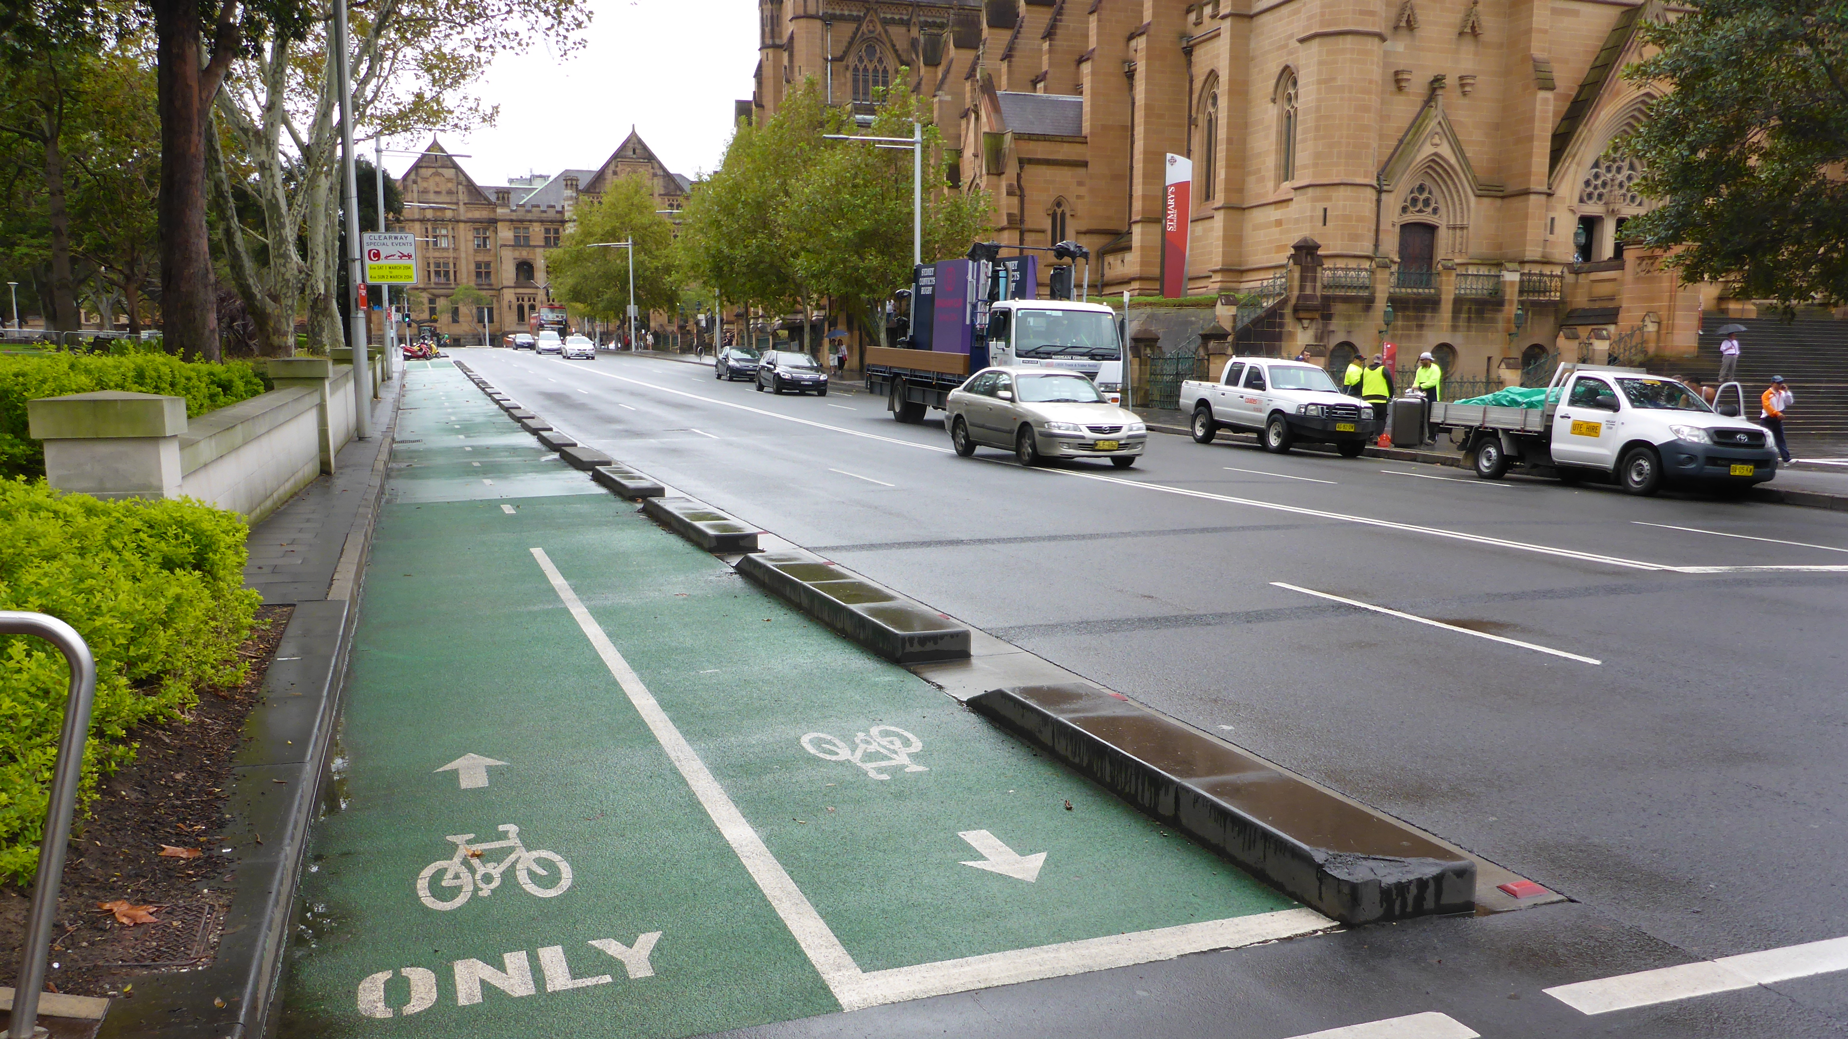
Solution
Creating a re-routing algorithm for bikers that:
Optimizes routes considering several individual preferences like time, traffic, pollution, temperature, noise, green paths/parks
Recommends safer and healthier routes
Informs about street blockades and instructions
Offers information about bike stations and bikes itself
Add some other info about healthy life related with bikers or usual user routes
This Photo by Unknown author is licensed under CC BY-NC.

